Slide 1
1.1 Number systems
How and why computers use binary to represent all forms of data

Slide 2

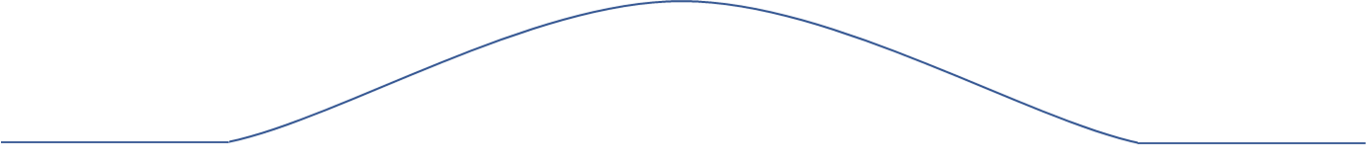
Living in an analog world
Analog signal

Slide 3
Living in an analog world
Digital signal
On
Off
Off
Analog signal

Slide 4
What is binary?
= 0
Off
= 1
On

Slide 5
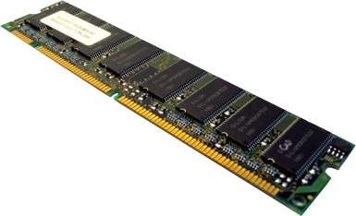
Random-access memory (RAM)

Slide 6
Random-access memory (RAM)

Slide 7
Random-access memory (RAM)

Slide 8
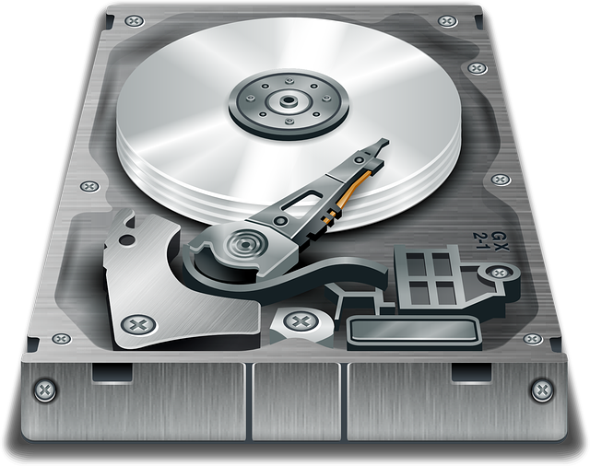
Hard disk
N
S
S
N

Slide 9
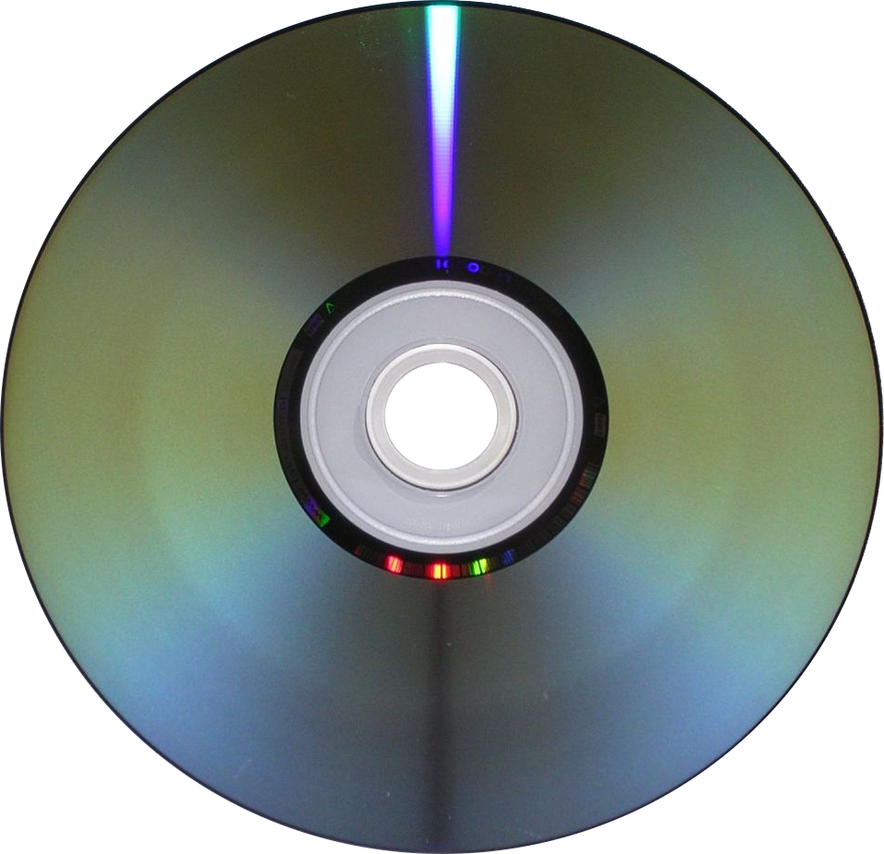
Optical disc
pit
land

Slide 10
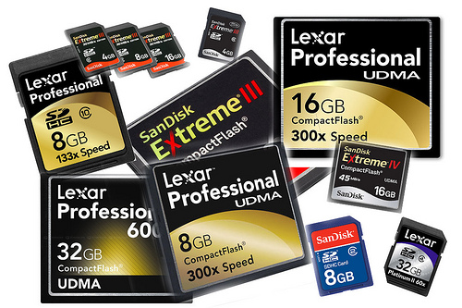
Solid-state memory

Slide 11
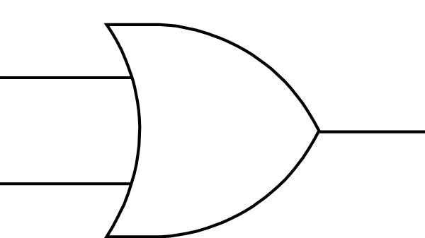


Logic gates
1
On
0
Off

Slide 12

With just two states, electronic components are:
Easier to manufacture
Therefore cheaper
More reliable
Examples of using two states to store data:
RAM
Optical disc
N
S
Flash memory
Hard disk
S
N

Slide 13


